Slide 1

English portfolio
By: Diego Roberto Cuéllar Meléndez 41 “B”

Slide 2
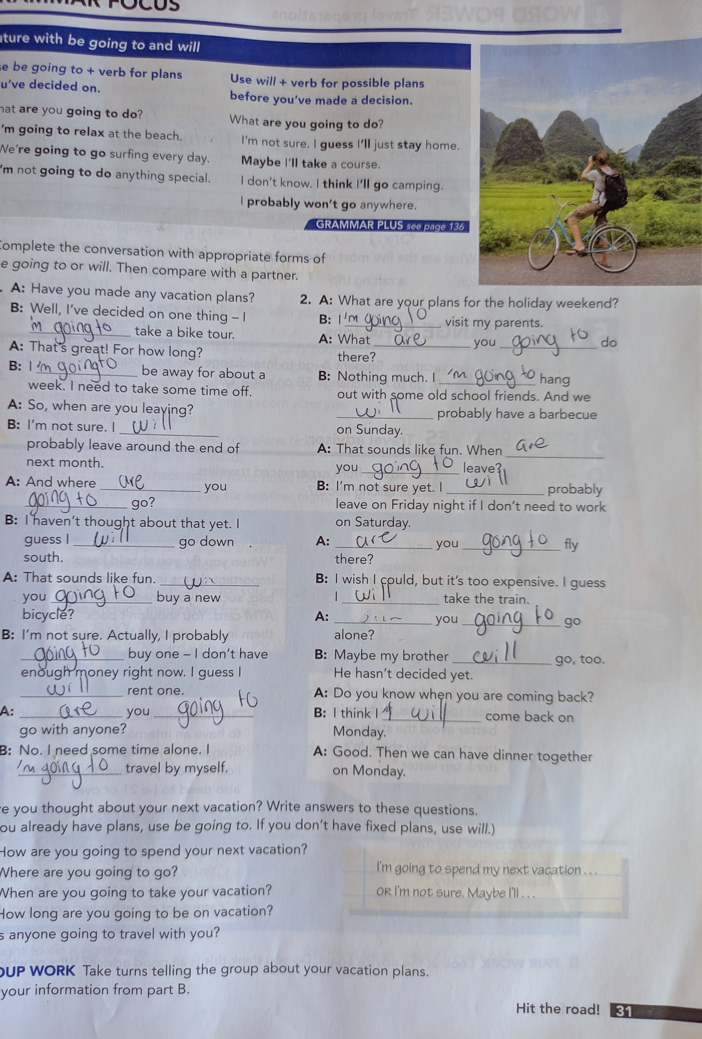
1st

Slide 3
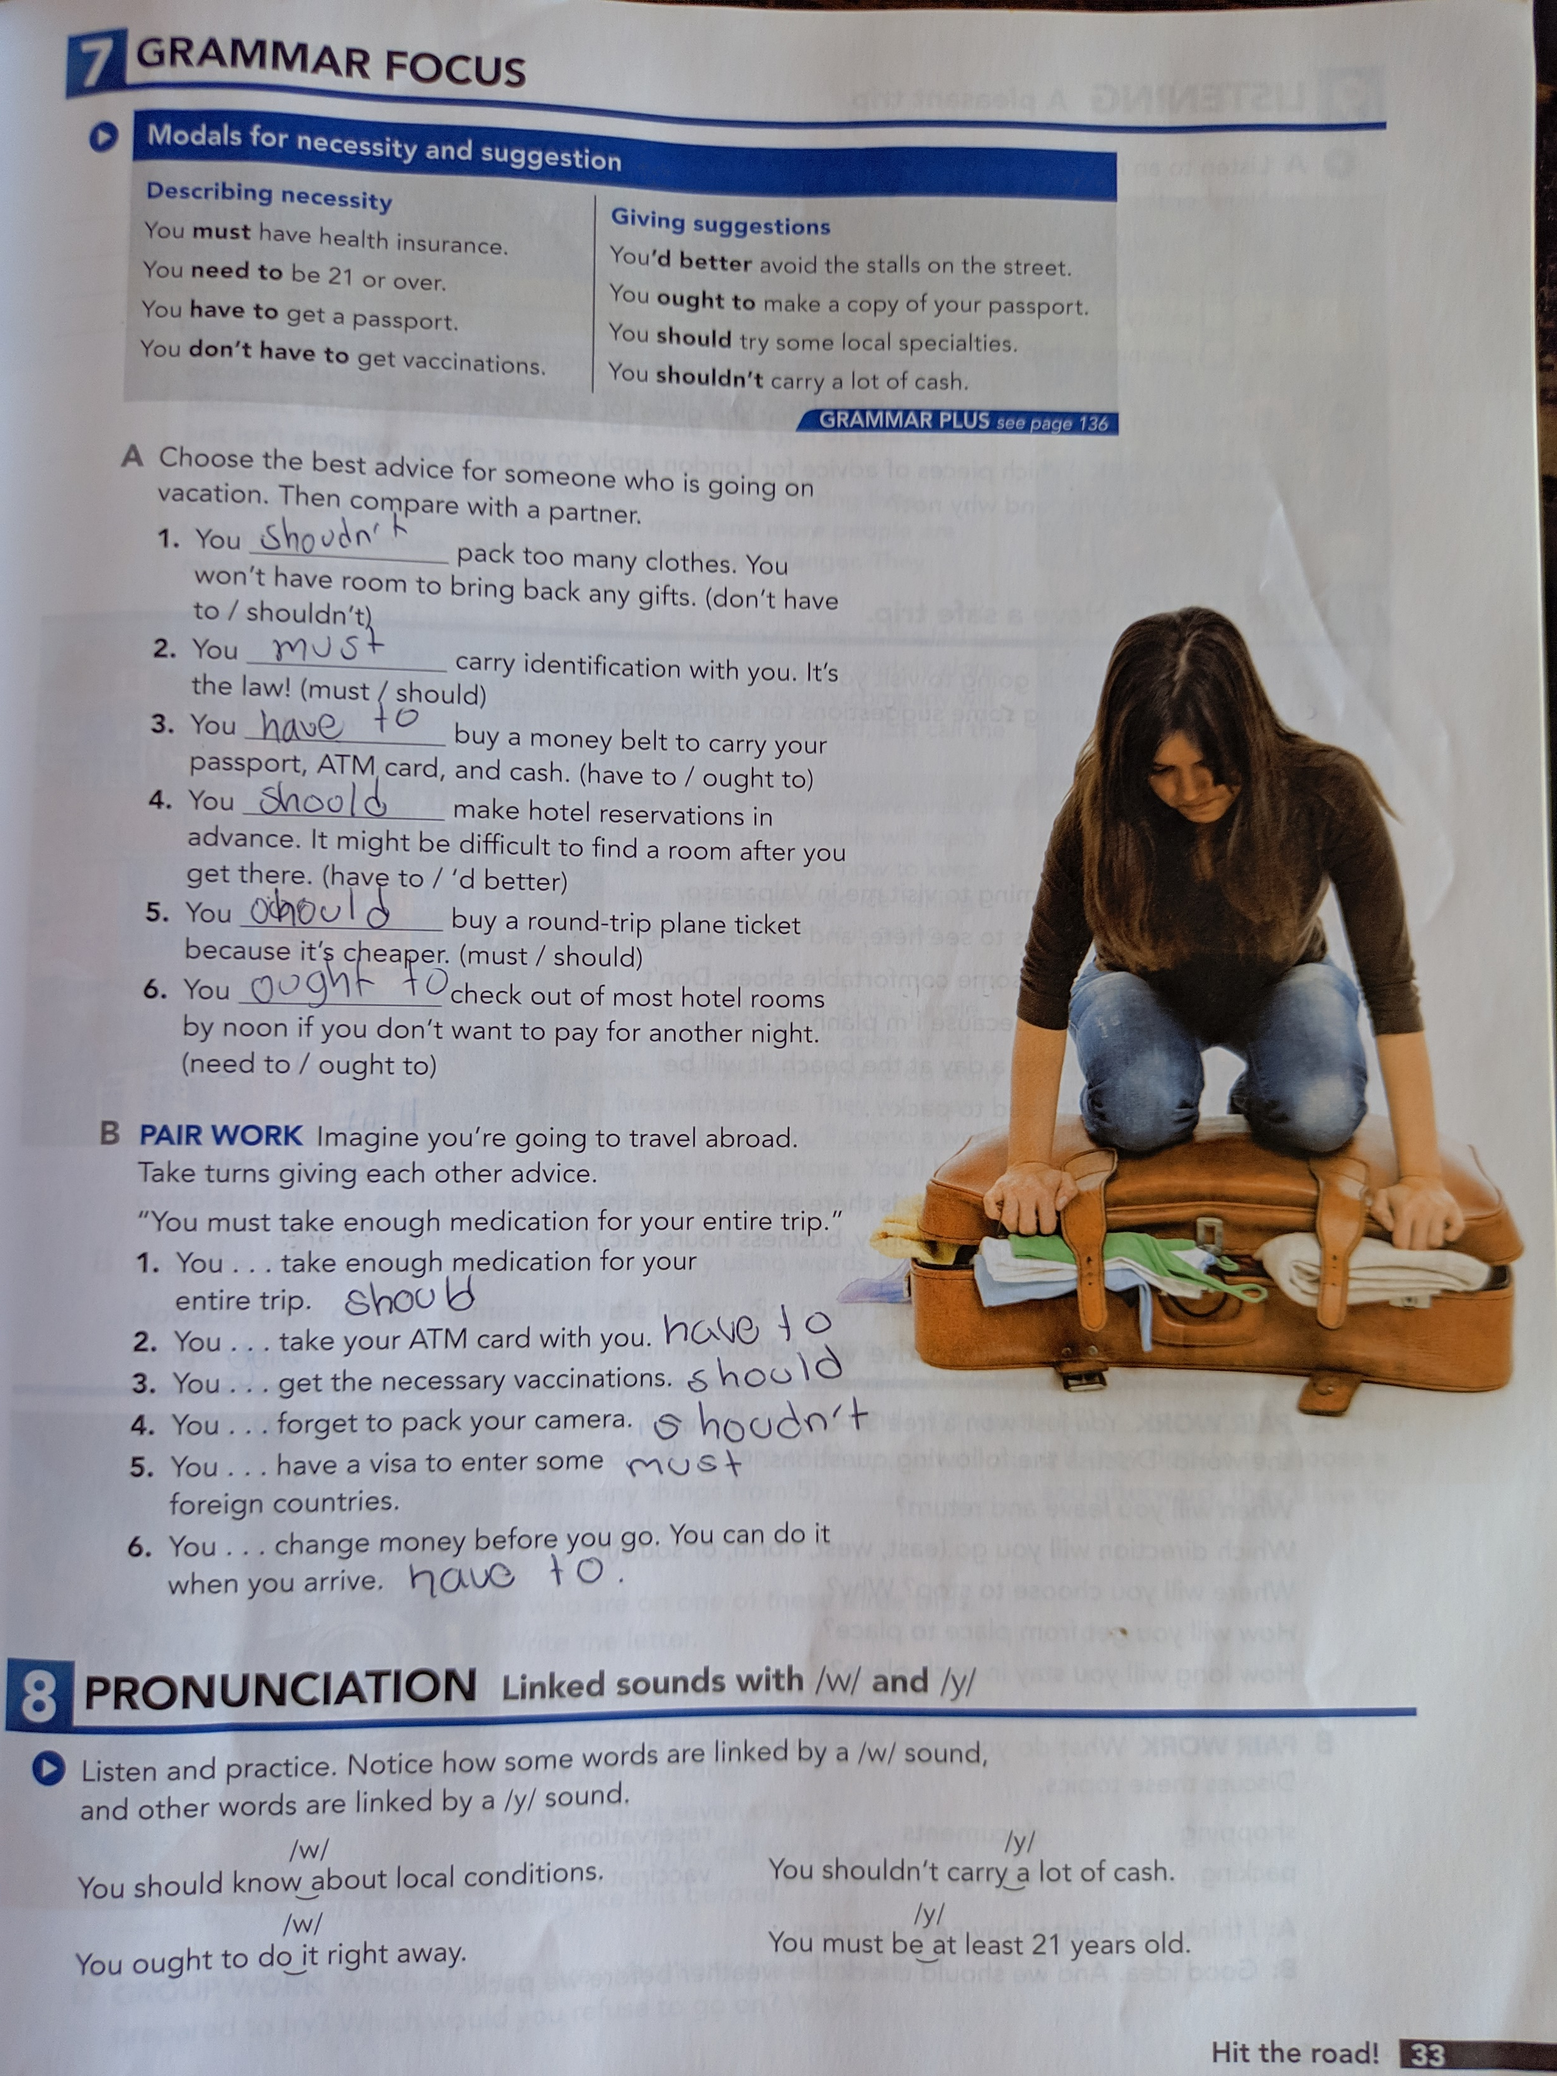
2nd

Slide 4
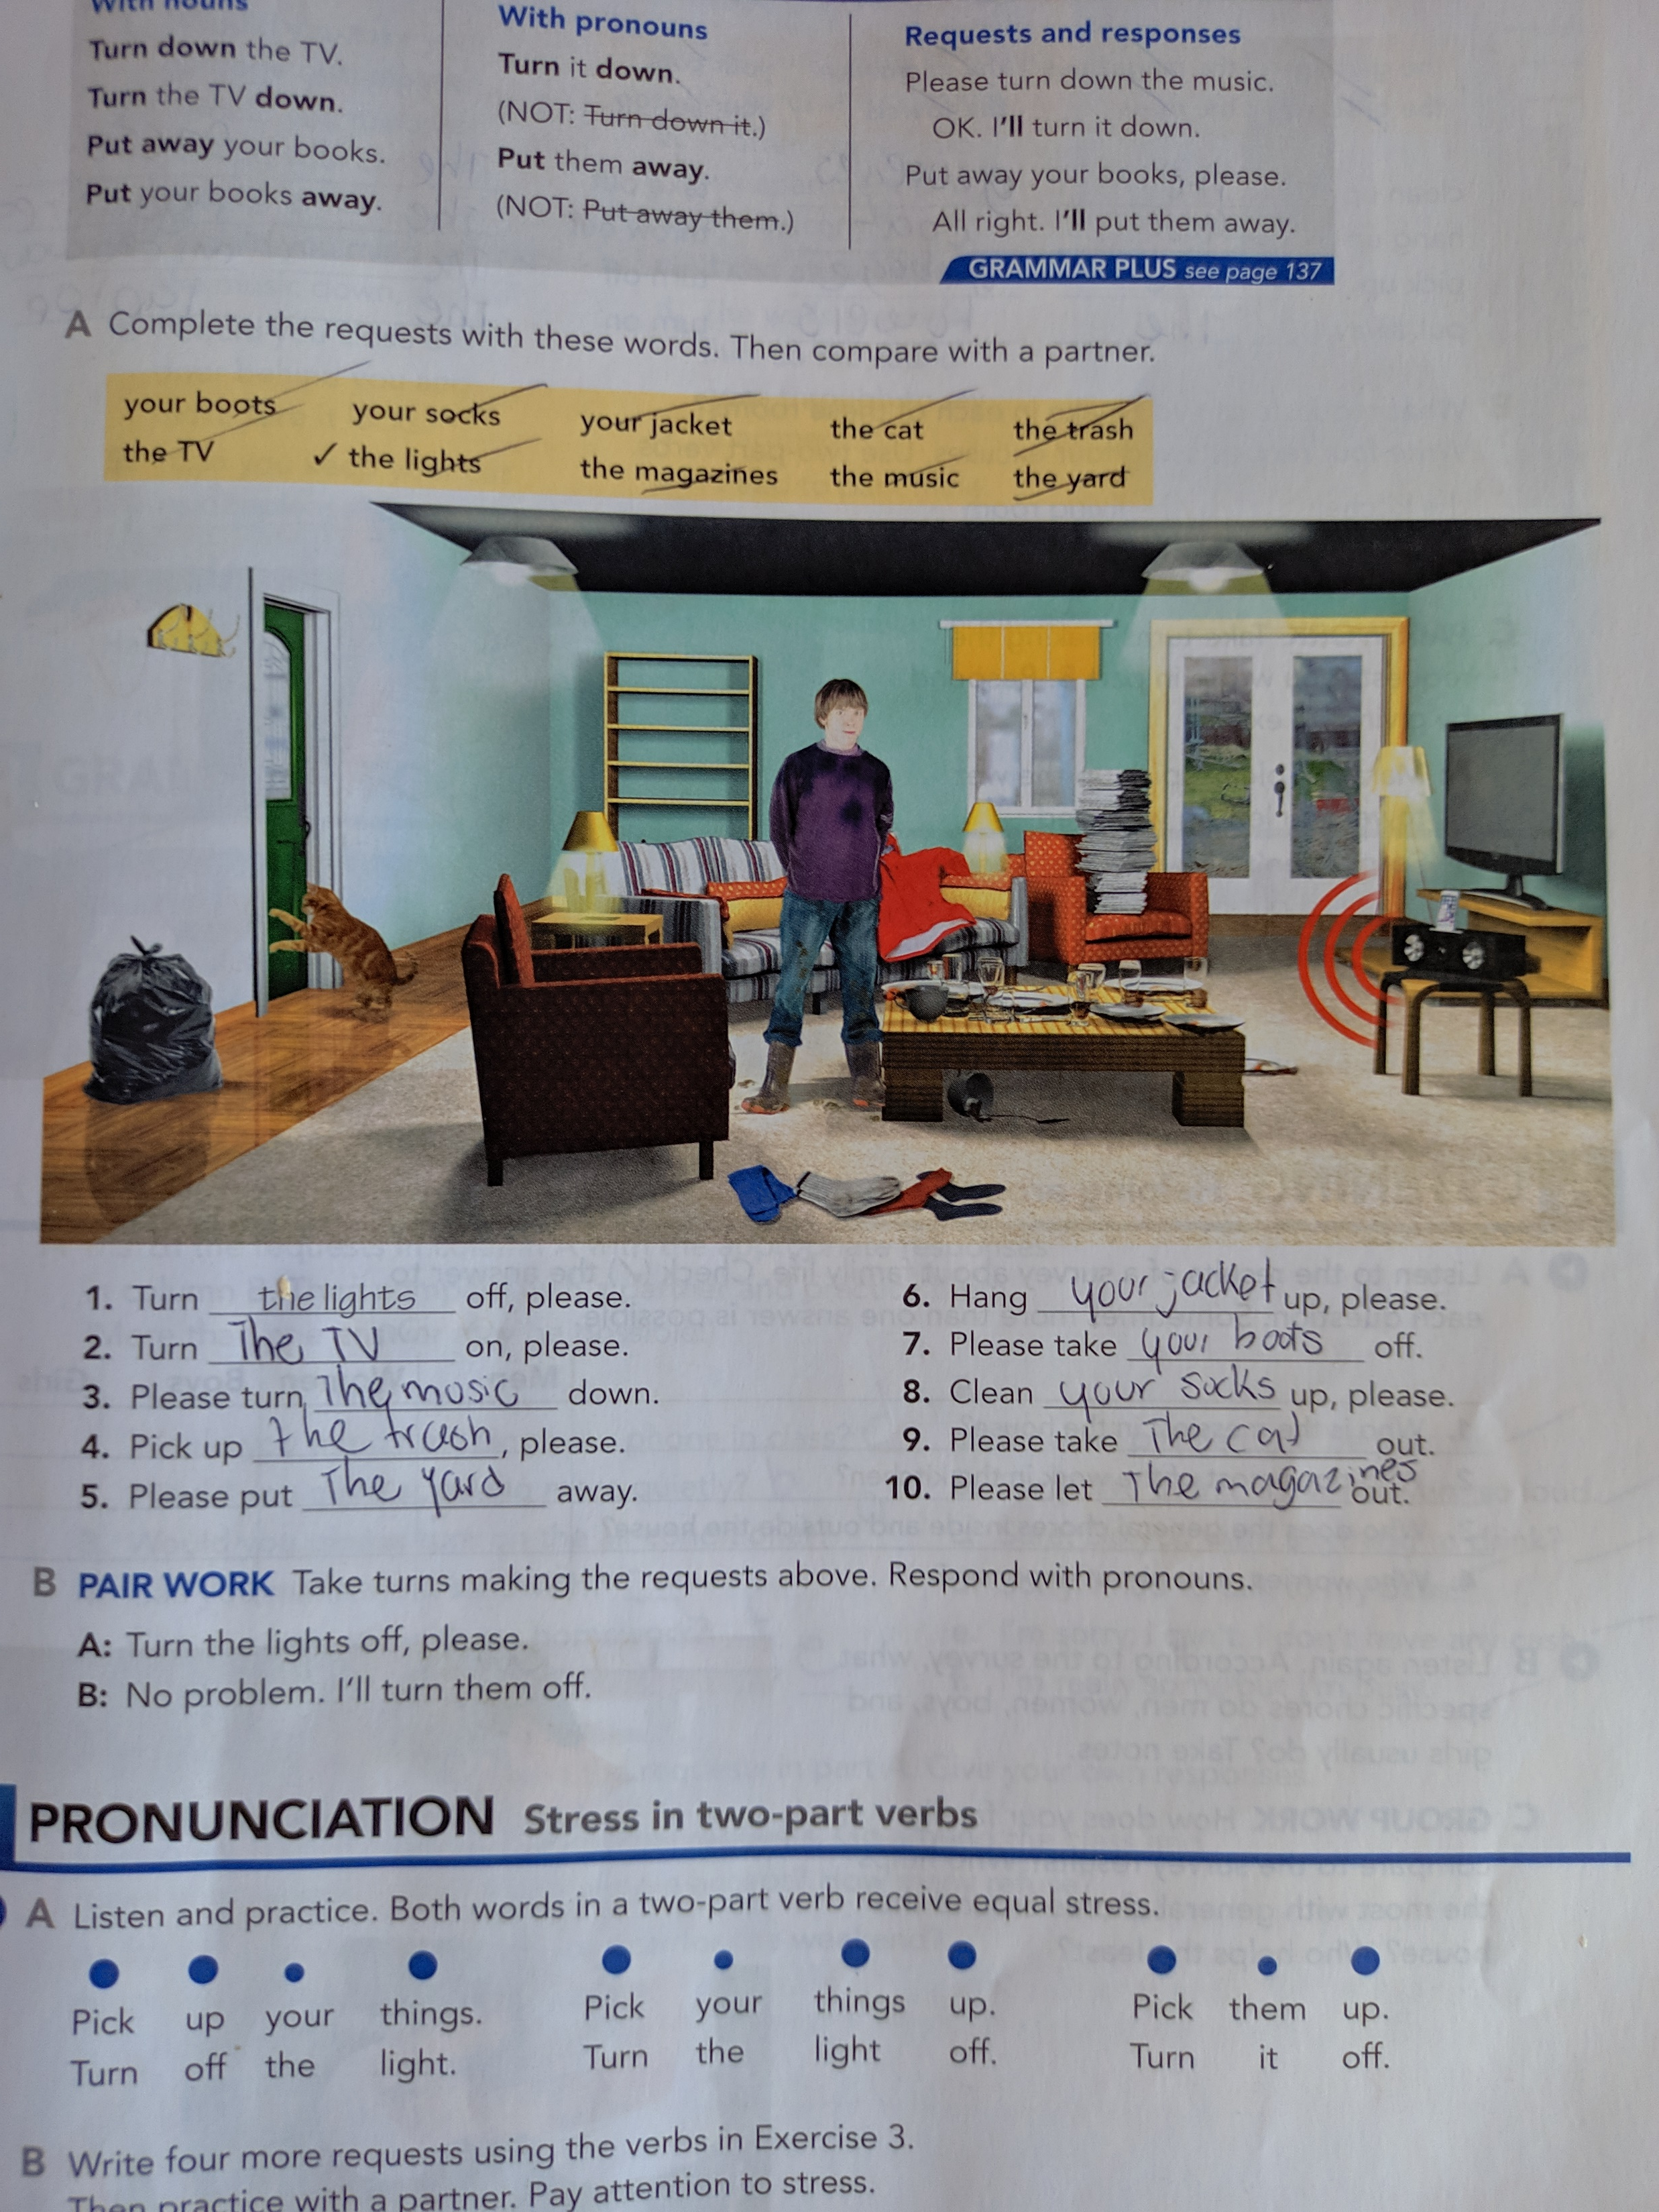
3rd

Slide 5
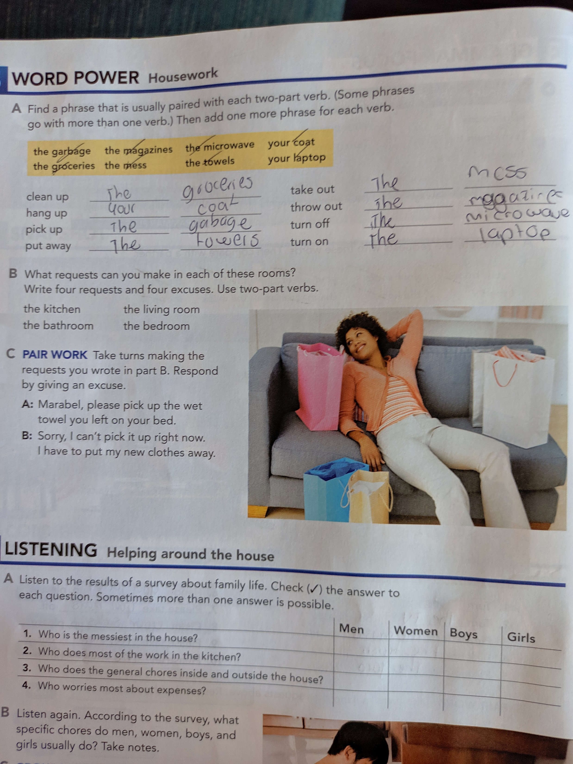
4th

Slide 6
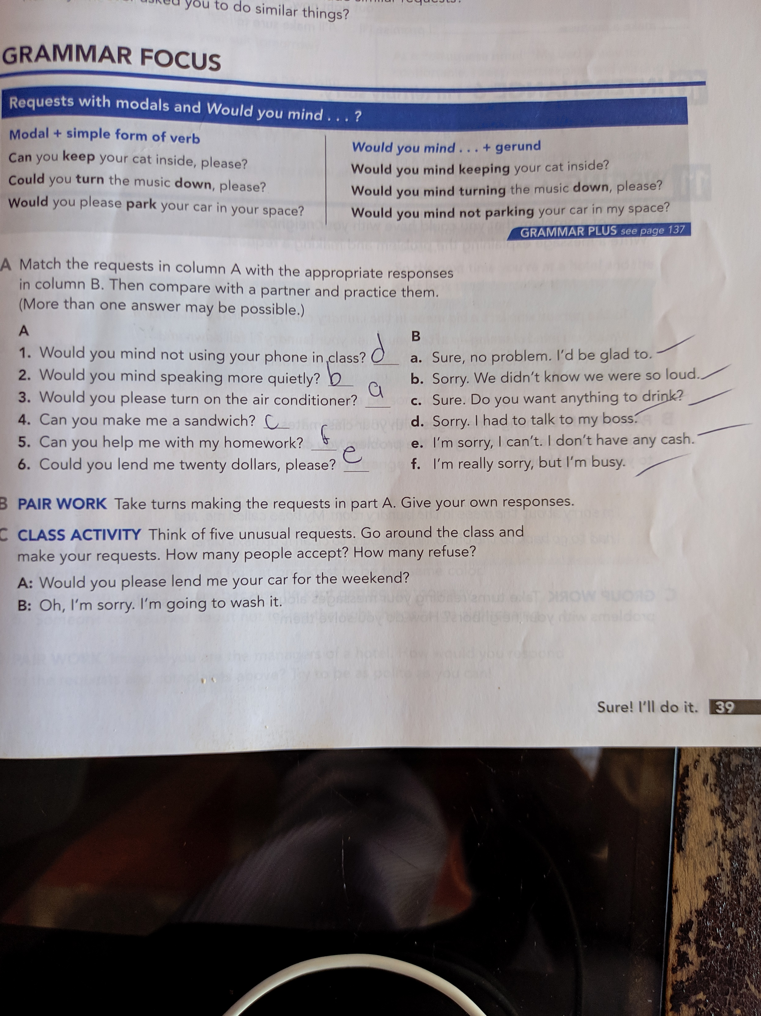
5th

